Slide 1
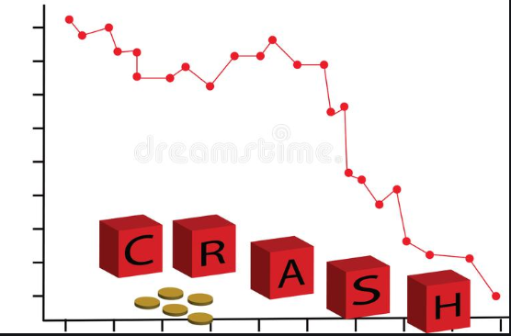
Stock Market Crash

Slide 2
What is a stock market crash?
It is a sudden dramatic decline of stock prices in a stock market, or across the stock markets.
This sudden decline always leads to loss of paper wealth.

Slide 3
Stock market crashes are driven by panic as much as by underlying economic factors.
They often follow speculation and economic bubbles.
A stock market crash is a social phenomenon where external economic events drives more market participants to sell.

Slide 4
Generally speaking, crashes usually occur under the following conditions:
A prolonged period of rising stock prices and excessive economic optimism,
A market where price–earnings ratios exceed long-term averages,
Extensive use of margin debt and leverage by market participants.

Slide 5
Other aspects such as:
wars
large-corporation hacks
changes in federal laws and regulations
natural disasters of highly economically productive areas may also influence a significant decline in the stock market value of a wide range of stocks.

Slide 6
All such stock drops may result in the rise of stock prices for corporations competing against the affected corporations.
Crashes are often distinguished from bear markets by panic selling and abrupt, dramatic price declines.
Bear markets are periods of declining stock market prices that are measured in months or years.
Crashes are often associated with bear markets, however, they do not necessarily go hand in hand.

Slide 7
Crashes are generally unexpected.
As Niall Ferguson stated,
"Before the crash, our world seems almost stationary, deceptively so, balanced, at a set point. So that when the crash finally hits — as inevitably it will — everyone seems surprised. And our brains keep telling us it’s not time for a crash.”

Slide 8
Stock market crashes in India
These crashes or falls happen in two stock markets of India, namely the Bombay Stock Exchange (BSE) and National Stock Exchange (NSE).
Stock markets in India have seen number of booms as well as crashes.

Slide 9
According t financial times, a double-digit percentage fall in the stock markets over five minutes is a crash.
While Jayadev et al. describe a stock market crash in India as a "fall in the NIFTY of more than 10% within a span of 20 days" or "difference of more than 10% between the high on a day and the low on the next trading day" or "decline in the NIFTY of more than 9% within a span of 5 days.

Slide 10
Some prominent stock crashes in India are:
Crash of 1991
After the liberalization of India in 1991, the stock market saw a number of cycles of booms and busts, some related to scams such as those engineered by players such as Harshad Mehta and Ketan Parekh, some due to global events and a few due to circular trading, rigging of prices and the irrational exuberance of investors leading to bubbles that finally burst.

Slide 11
Crash of 1992
On 28 April 1992, the BSE experienced a fall of 12.77% - its largest fall in history (in terms of percentage) due to the Harshad Mehta scam.
Crash of 2006
On 18 May 2006, the BSE Sensex fell by 826 points to 11,391.

Slide 12
Crashes of 2007
During the financial crisis of 2007–2008, the stock markets in India fell on several occasions in 2007 as well as 2008. In 2007, there were five sharp falls in the stock markets.

Slide 13
2 April 2007: The sensex fell by 617 points to 12,455 though during the course of the day, it fell further.
1 August 2007: The sensex continued to fall and finally settled at 14,936 while the nifty fell by 183 points to 4,346
16 August 2007: The sensex continue to languish a good 500 points down for most of the trading session, finally closing at a low of 14,358, a loss of 643 points.

Slide 14
18 October 2007: The sensex tumbled all the way to a low of 17,771 - down 1,428 points from the same day's high. It finally settled on 17,998 with a loss of 717 points (3.8%). The Nifty too lost 208 points and closed at 5,351.
21 November 2007 The index tumbled to a new low of 18,515 - down 766 points from the previous day's close. It finally ended with a loss of 678 points at 18,603. The Nifty also lost 220 points to close at 5,561.

Slide 15
17 December 2007: As per rediff, "Again, a heavy bout of selling in the late noon deals saw the BSE Sensex plunge to a low of 19,177 - down 856 points from the day's open. The Sensex finally closed at 19,261 - a fall 0f 769 points (3.8%). The NSE Nifty 50 ended at 5,777, down 271 points

Slide 16
Crashes of 2008
On 21 Jan 2008, the BSE fell by 1408 points to 17,605 leading to one of the largest erosions in investor wealth
On the next day on 22 January 2008, the Sensex again fell by 875 points to 16,729.Jan 22, 2008 The Sensex saw its biggest intra-day fall on Tuesday when it hit a low of 15,332, down 2,273 points.

Slide 17
On 11 Feb 2008, the Sensex fell by a further 834 points to 16,630.
On 3 March 2008, the Sensex fell by 900 points to settle at 16,677.
On 17 March 2008, the BSE Sensex fell further to 14,809 - a fall of 951 points.
On 24 October 2008, the BSE Sensex fell to 8701, a fall of 1070 points in a single day.

Slide 18
Crash of 2009
On 6 July 2009, the Sensex fell by 869 points to 14,043.
Crashes of year 2015
On 6 Jan 2015, the Sensex fell by 854 points to 26,987
On 24 August 2015, the BSE Sensex crashed by 1,624 points and the NSE fell by 490 points.

Slide 19
Crashes of 2016
By 16 February 2016, the BSE had seen a fall of 26% over the past eleven months, losing 1607 points in four consecutive days of February.
On 9 November 2016, crashed by 1689 points

Slide 20
Crashes of 2020
On 9 March 2020, the Sensex fell by 1,941.67 points, the second biggest single-day fall in the history while Nifty-50 broke down by 538 points.
On 12 March 2020, the Sensex fell by 2919.26 points (-8.18% ), the worst continuation of the week in the history while Nifty-50 broke down by 868.25 points (-8.30% ) amid World Health Organisation (WHO) declaring Coronavirus outbreak as "pandemic". Sensex ended to 33-month low of 32778.14.

Slide 21
The biggest crashes were seen on march 19 and 20 of 2020, each day stock market was down by more than 2000 points.
On 20 march stock market was closed for a while due to its opening crash.

